Slide 1
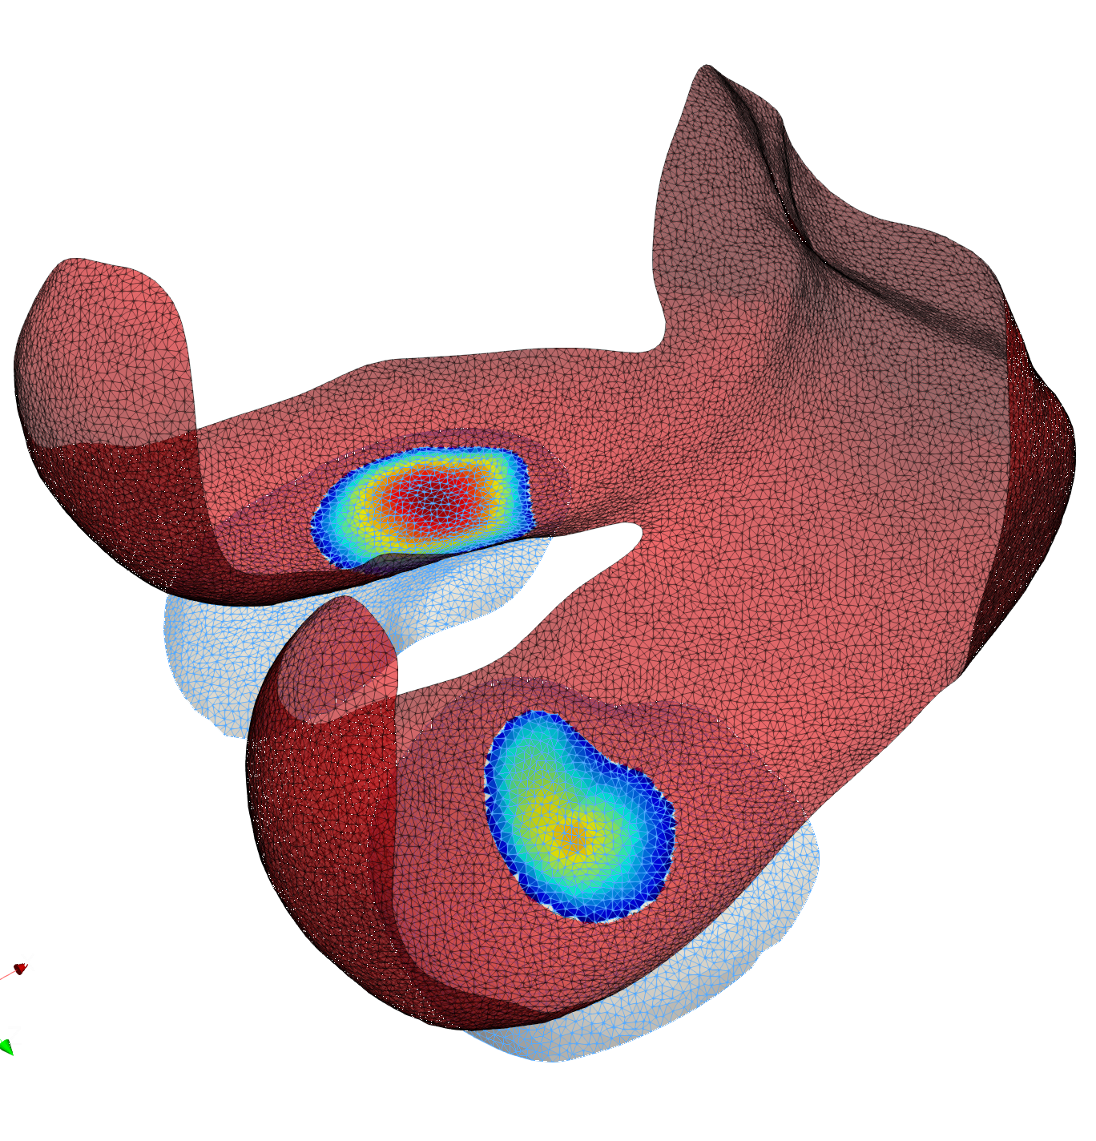
Tibia
Normal
casting_mesh
Center
Proximity (+)
Femur
Normal
target_mesh
Normal
Femur
target_mesh
Proximity (-)
Normal
Center
Tibia
casting_mesh

Slide 2
Normal
casting_mesh
Proximity
target_mesh

Slide 3
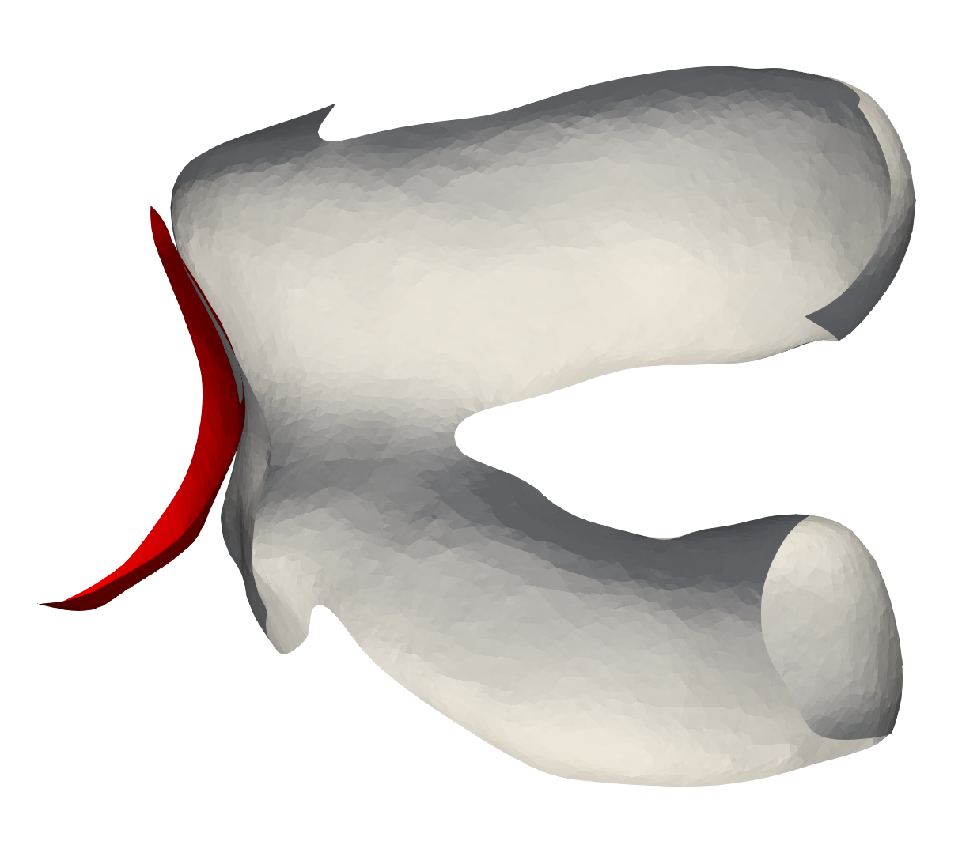

Slide 4
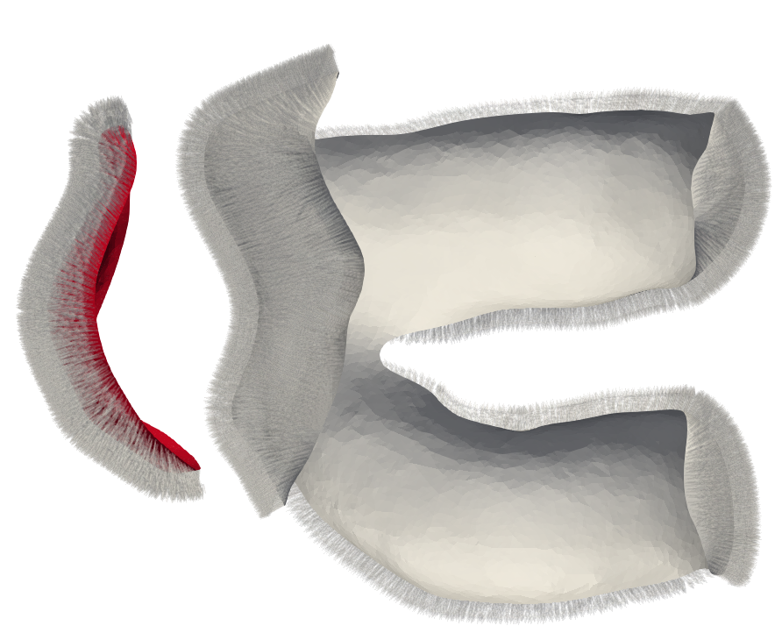

Slide 5
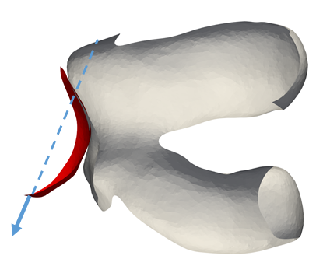

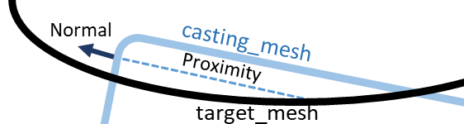
Case 1
Case 2
Case 3

Slide 6
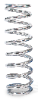
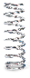
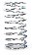
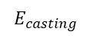
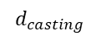
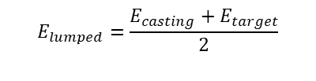
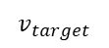
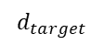
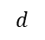
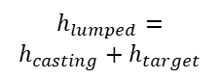
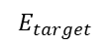
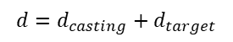
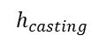
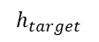
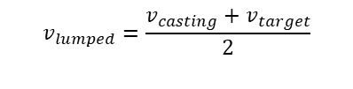
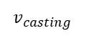
use_lumped_contact_model = true
use_lumped_contact_model = false
Rigid
Rigid
$$E_{lumped}=\frac{E_{casting}+E_{target}}{2}$$
$$E_{target}$$
$$h_{target}$$
$$h_{lumped}=$$
$$h_{casting}+h_{target}$$
$$v_{target}$$
$$v_{lumped}=\frac{v_{casting}+v_{target}}{2}$$
$$E_{casting}$$
$$h_{casting}$$
$$v_{casting}$$
Rigid
Rigid
$$d_{target}$$
$$d$$
$$d_{casting}$$
$$d$$
$$d=d_{casting}+d_{target}$$

